Slide 1
China
Student Name
Institution Affiliation

Slide 2
Introduction
China is the worlds most populous country located in East of Asia.
China Emerged one of the worlds' earliest civilization
Chinese rulers isolated their societies from Europeans during this ages of exploration 1400 – 1800
China’s imperialism history has made the rise of different interesting stories over the 19th and the 20th centuries.
Chinese leadership was characterized by dictators who accelerated for wars during decolonization.
China’s Industrial Revolution took place stepwise.
Notes:
China is the world’s most populous country; it emerged to be one of the world’s earliest civilizations, Chiba has a wide history that can be precisely followed to understand more of its early times. Focusing on four historical periods that is the age of exploration, age of modern Imperialism, Age of Decolonization, and age of industrial; revolution, different historical events to place in China during these periods. For instance, During the ages of exploration, Chinese rulers isolated their societies from the Europeans, The age of modern Imperialism in China created two interesting stories, Wars during the age of Decolonization was accelerated by the Chinese leadership, and Chinese Industrial revolution took place in several steps (Parker, 2010).

Slide 3
Age of Exploration and Encounter (1400-1800)
China much isolated itself from European during the age of exploration.
China official trade policies in 1500s much reflected its isolation.
At the beginning of 1500s, china had an isolationist trade policy
The Ming Dynasty kept China to itself for the most part.
Trade with foreigners became encouraged after China reversed its trade policy in middle 1500s.
Revised trade policy made both merchants and farmers start to grow.
Notes:
One of the major events that took place in China during the period of exploration was the enactment and changes in China trade policy in the 1500s. The Isolationist trade policy at the beginning of the 1500s did not allow trading with foreigners. However, the policy changed in the course of the century, making the merchant class become more powerful and rich. Some cases of Imperial trade was allowed by previous dynasties, but Ming dynasty kept China to itself for the most part(Parker, 2010).

Slide 4
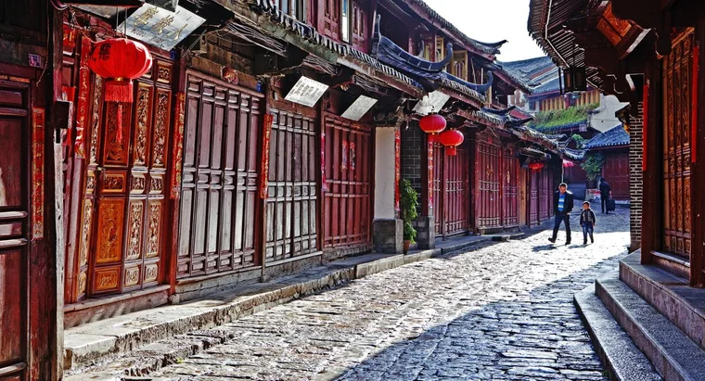
Age of Exploration and Encounter (1400-1800) Cont’d
Revision of China trade policy in middle 1500s gave Chinese Citizen freedom to work as they wished.
Blurring of class lines existed during middle 1500s.
These classes started entering government
Dynasty prospered for next 70 years.
Notes:
The revision of China trade policy, allowing foreigners to trade in China gave citizens the freedom to work as they wished. Additionally, it leads to the rise of blurring class lines. These classes were allowed by the government to take Imperial examination and enter government since they were educated and had money.

Slide 5
Age of Modern Imperialism (1800-1945)
The main motive of British Imperialism in China in 19th Century was economic.
In 1823, 20,000 Chests of Opium were Imported to China.
In 1836, Quig Court formally prohibits all imports of Opium and attempted to close the ports of Canton and Shanghai.
The Opium, war remained to be the first large scale military conflict that existed between the Quig Empire and western imperial powers.
Notes:
During the age of modern Imperialism, the main motive in China was Economic. Approximately 20,00 chest of Opium was imported to China in 1823, and later the importation was prohibited in 1836 which much contributed to the Opium war that happened between 1836 and 1842 (Tao, n.d.).

Slide 6
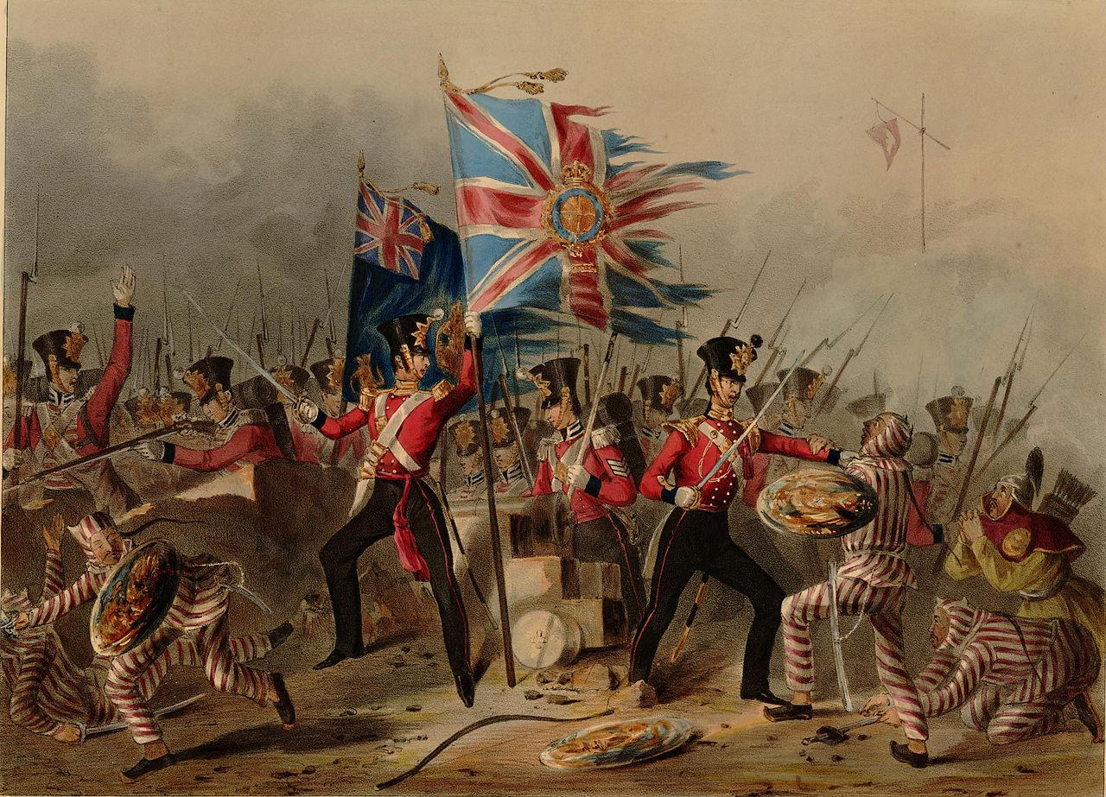
Age of Modern Imperialism (1800-1945) Cont’d
A campaign to confiscate all foreign Imported Opium in Canton was launched by Quig government after official Opium prohibition.
The Opium war made China loose Hong Kong Island.
TH Opium war also revealed the military weakness of the Quig Government.
After Quim war, China began top experience several disadvantageous economic pressure from European Empires such as British.
Notes:
Not only did China prohibit importation of Quim, but also the Quig government went a step further to launch a campaign aimed at confiscating all foreign imported Quim in Canton. The results of the Opium war were not much pleasing to China. First, the wart made China lose the most precious Island at that time, Hong Kong Island. Also, the war made China start receiving disadvantageous economic pressure from European empires, especially British. However, the war made China realize its military weakness, and in the long run, enabled China to make subsequent movements of military industrialization and self-strengthening (Tao, n.d.).

Slide 7
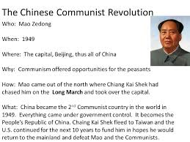
Age of Decolonization (post-1945)
In 1949, Chinese Communist Revolution took place
People’s Republic of China was proclaimed on 1st October 1949.
Revolution began in 1946 after end of Second Sino-Japanese War
The United States Suspended diplomatic ties with the PRC for Decades after fall of mainland China to communism.
Notes:
Led by the Communist Party of China, which was under the leadership of Mao Zedong, the Chinese Communist revolution proclaimed the Peoples Republic of China. In 1949. This revolution was the Second part of the Chinese Civil War and began after the Second Sino-Japanese war. However, some of the negative results of the fall of Mainland of China to communism in 1949 is that the United States suspended all diplomatic ties with China for several decades (Fraser, 2013).

Slide 8
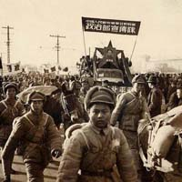
Age of Decolonization (post-1945) Cont’d
Some of the factors that lead to success of Communists though never hold any major cities after World war II include;
Thy had strong grassroots support
They had superior military morale and organization
They had large stock of weapons that were seized from Japanese supplies in Manchuria.
Notes:
Eventual Communist victory seemed more and more likely as the Civil war gained strength from 1947 to 1949. The success of Communist after the end of World War II was much prompted by several things including their strong gained grassroots support, superior military organization and morale, and availability of large stock of weapons seized from Japanese supplies in Manchuria (Fraser, 2013).

Slide 9
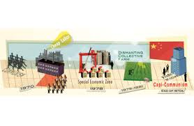
Industrial Revolution
1978 to 1988 marked the proto-industrialization phase.
Sprouting of millions of rural enterprises was experienced in this phase.
These enterprises acted as engines of economic growth
1988 to 1998 marked the first industrial revolution phase in China.
The phase featured mass production of labor intensive light consumer goods.
The phase rely mainly on imported machinery for production
China became the largest producer and exporter of textiles among others.
Notes:
The industrial revolution in China can be categorized into three phases, and Proto-industrialization was the first phase, which was featured by sprouting of millions of rural enterprises. During this period, the number of village firms greatly increased, making the village industrial gross output top increase more than 13.5 folds. The second period was the first industrialization phase, which was featured by mass production of labor-intensive light consumer goods across China urban as well as rural areas. This period made China become the largest producer and exporter of textiles, the largest producer and exporter of toys and furniture, and the largest producer and importer of cotton (Wen, 2016).

Slide 10
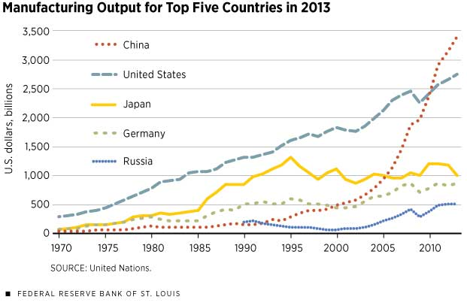
Industrial Revolution Cont’d
1988 to present marks the third period of China industrialization known as second industrial revolution phase.
This phase is characterized by mass production of means of mas production
Increased machinery and transportation
Notes:
The last period of China revolution is the second industrial revolution phase mostly characterized by mass production of means of mass production. This period has experienced increased consumption and production, mainly characterized by increased machinery use and better transportation (Wen, 2016).

Slide 11
References
Fraser, C. (2013). Decolonization and the Cold War. The Oxford Handbook of the Cold War, 745-746.
Tao He. (n.d.). British Imperialism in China | Guided History [Video file]. Retrieved from http://blogs.bu.edu/guidedhistory/moderneurope/tao-he/
Yi Wen. (2016, April 12). China's Rise from Agrarian Society to Industrial Power | St. Louis Fed [Video file]. Retrieved from https://www.stlouisfed.org/publications/regional-economist/april-2016/chinas-rapid-rise-from-backward-agrarian-society-to-industrial-powerhouse-in-just-35-years
Parker, C. H. (2010). Global interactions in the early modern age, 1400–1800. Cambridge University Press.

